Slide 1
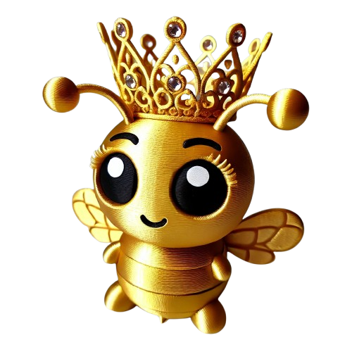

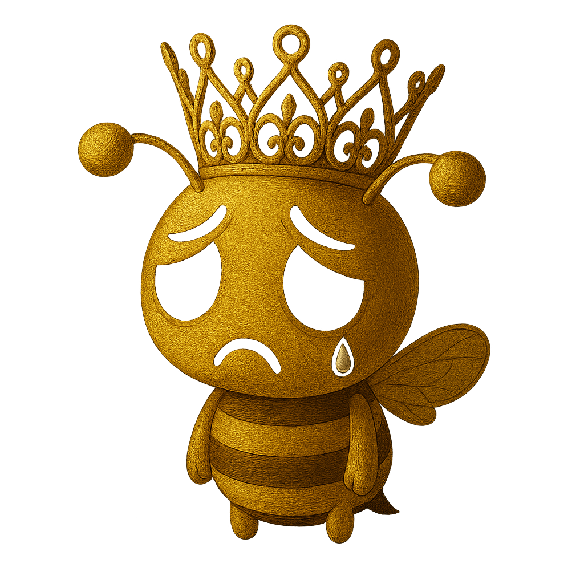



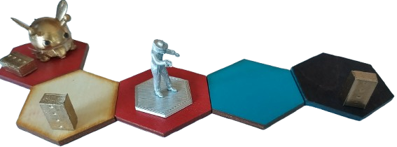
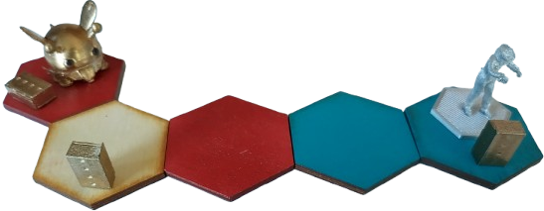
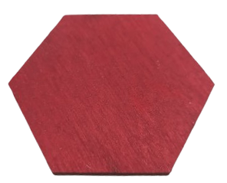

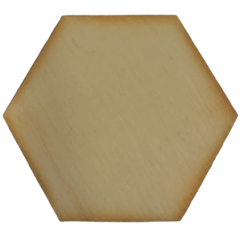
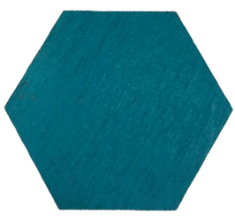
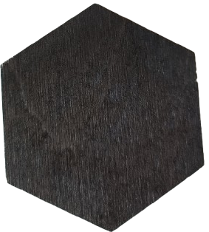

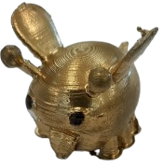











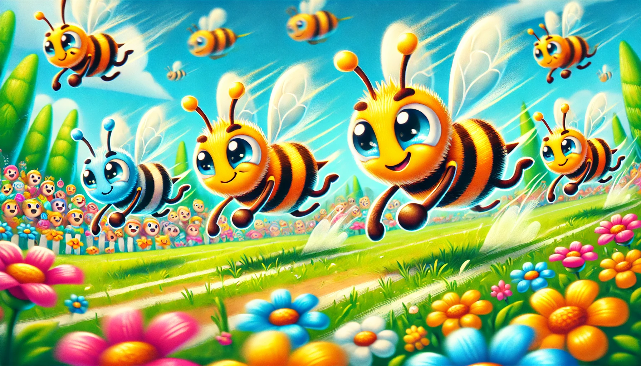

GOAL: Collect 10 points to save the Queen bee!
BEWARE: You lose if you have no healthy hives
Roll Dice
2. Actions
Who starts first? 🏁 Ate honey most recently
Roll the 🎲
You can take TWO actions. You can choose from 2 of the following 3 options.
🎲 |  | Challenge |  | Effect
 |  | Varroa Mite |  | A hive is damaged*
 |  | Climate Change |  | A garden tile is damaged*
 |  | Pesti- cides |  | Bee can only collect water this round
 |  | Extreme weather |  | Bee cannot move this round
 |  | Extreme weather |  | A hive is damaged*
 |  | Garden |  | Extend the garden
Action beekeeper
Move the beekeeper in a straight line, then choose one of the following actions to perform.
Action bee
Move the bee in a straight line. If the tile you land on has a healthy hive, collect two resources as described below. If there is no Hive collect only one resource.
`
 | Action
 | Repair a hive
 | Repair a garden tile
 | No spray zone: Protects a garden tile from pesticide
 | Smart hive: Protects hive from Varroa Mite
 | Wildlife reserve: This garden tile is protected from being removed
Location |  | Action
 |  | Collect 2 X pollen
 |  | Collect 2 X nectar
 |  | Collect 2 X water
+
Action gardening
* If damaged again, hive or tile is destroyed and removed from the board
Note:Gardens can not be added in a single straight line
 | Action
 | Extend the garden with a new tile
+
3. Trade
Next players turn!
Convert your nectar, pollen and water for goods.
Cost |  | Object | Value
 |  | Honey | 1
 |  | Bee bread | 2
 |  | Hive | 0
Your teammate(s) manage and respond to the environment by completing steps 1-3
1
+
1
+
1
2
+
3
2
+
3

Slide 2
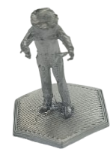
Setting up
Legend
Build the garden
Assign a banker who controls the player pieces.
Select 5 garden tiles and join them together as you want to.
This is an example starting map
 | Pieces
 | Pollen garden tile
 | Nectar garden tile
 | Water garden tile
 | Pollen. Collected by the bee on a pollen garden tile with a healthy hive
 | Nectar. Collected by the bee on a nectar garden tile with a healthy hive
 | Water. Collected by the bee on a water garden tile with a healthy hive
 | Hive. Can be bought for 2 honey ( ) and 3 bread ( ) Worth 0 points
 | Beekeeper
 | Bee
 | Honey. Can be bought for 1 pollen ( ) , 1 nectar ( ) and 1 water ( ) Worth 1 point
 | Honey bread. Can be bought for 2 honey ( ) and 3 bread ( ) Worth 2 points
 | Smart hive. Protects hive from Varroa Mite
 | Wildlife reserve. Garden tile is protected from being removed
 | No spray zone. Protects a garden tile from pesticide
If a garden tile is damaged* it is flipped over
* if a tile is damaged also lose one of the resources it represents.
A bee can’t move through a damaged tile.
2. Place the hives
Place hives on 4 of the garden tiles
If a hive is damaged it is tipped over
3. Place the beekeeper and the bee
Place the beekeeper and the bee on one of the garden tiles

